Slide 1
بِسْمِ اللهِ الرَّحْمٰنِ الرَّحِيْم

Slide 2
FPGA Based LED Brightness Controller using pwm
Digital Logic Design [EEE241]
Semester Project
Irfan Danish [FA15-BEL-012]
Hammad Munir [FA15-BEL-034]

Slide 3
Contents :
Introduction.
Background.
Block Diagrams & Modules.
Description of Modules (Working).
Output.

Slide 4
Introduction:
LED Brightness controller based on PWM (Pulse Width Modulation).
Spartan 6 XC6SLX9 used to implement the project.
ModelSim SE 5.7f is used for Programming & Simulation.
Xilinx ISE 12.2 is used to implement the code on FPGA.

Slide 5
Background
PWM: Pulse-width modulation (PWM), is a modulation technique used to encode a message into a pulsing signal. It is achieved by changing the width of the signal & keeping the time period or frequency same.
Some of the important applications of PWM are:
PWM can be used to control LED brightness.
PWM can be used to mix RGB color, with an RGB (red green blue) LED.
PWM can be used to control the angle of a servo motor attached to something mechanical like a robot arm.

Slide 6
Background
When working with PWM one of the important thing to know is ‘Duty Cycle’.
Duty cycle is the proportion of time; during which a component, device, or system is operated. The duty cycle can be expressed as a ratio or as a percentage.

Slide 7
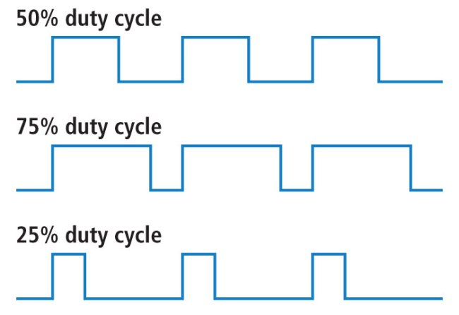
Duty Cycle

Slide 8
Block Diagrams & Modules.
There are total elven modules used in this project. Which are divided as:
main_led_brightness_controller
Top_button
Synchronizer
Top_debounce
Counter
Sm_debounce
Levl_puls_conv
Top_pwm_Generator
Selection_counter
N_rom
Pwm_Generator

Slide 9
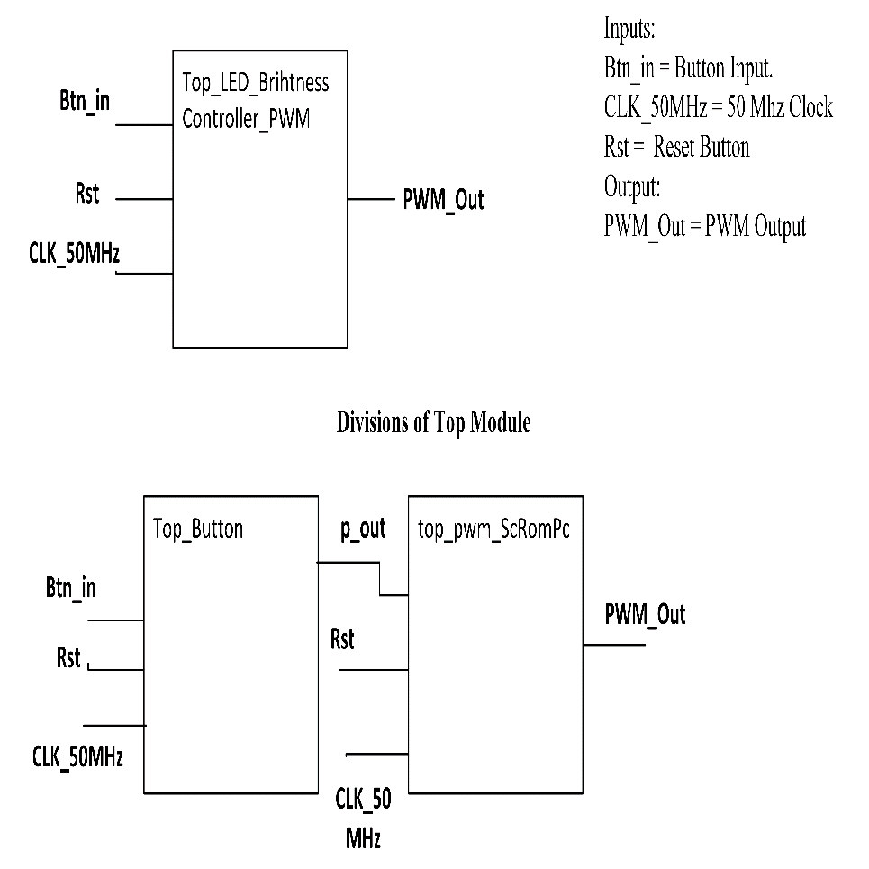
Block Diagrams & Modules.
Main Module

Slide 10
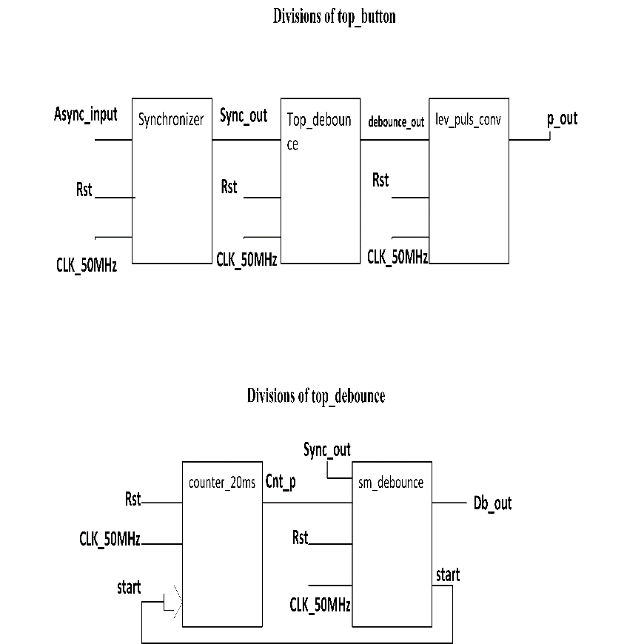
Block Diagrams & Modules.

Slide 11
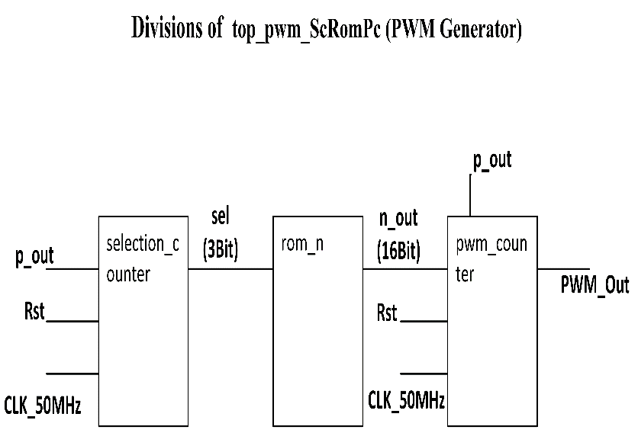
Block Diagrams & Modules.

Slide 12
Description of Modules (Working).
Main module connects the top modules ‘Top_button’ & ‘top_PWM_Generator’.
Top_button connects the ‘synchronizer’, ‘top debounce’ & ‘level pulse converter’.
Synchronizer: As, our finger is not synchronized to the clock, so the button is assumed to be an asynchronous signal. We have to make it synchronous. It performs synchronization.

Slide 13
Description of Modules (Working).
Top Debounce
Counter: It counts for 20 ms & generates delay for switch debouncing state machine.
Sm_debounce: The State Machine eliminates the debouncing effect of push button.
Level pulse converter:

Slide 14
Description of Modules (Working).
Top PWM Generator : It connects ‘Selection Counter’, ‘Rom’ & ‘PWM Generator’.
Selection Counter : It generates a unique binary code on every input.
Rom: It takes the binary code input from ‘Selection Counter ‘ & generates the value of time for which counters run.
PWM Generator : Take value of time from ‘ROM’ and decide for how much time output should remain high & low.

Slide 15
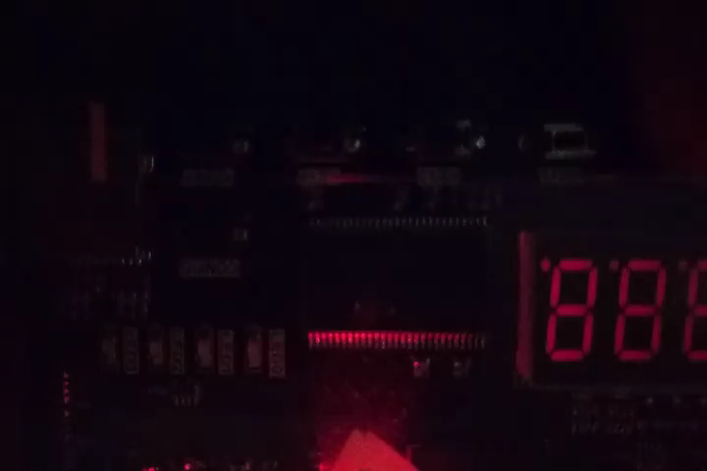
Output.

